Slide 1
AWS SQS and AWS SNS

Slide 2
AWS SQS and AWS SNS
Amazon Simple Queue Service (SQS) and Amazon Simple Notification Service (SNS) are both messaging services in Amazon Web Services (AWS) that can be used to decouple applications and enable asynchronous processing:
Amazon Simple Queue Service (SQS)
A pull-based message queuing system that stores messages.
SQS is used for background tasks, batch jobs, and other workloads that can be parallelized.
Amazon Simple Notification Service (SNS)
A push-based pub/sub service that sends messages to multiple subscribers.
SNS is used for application-to-application (A2A) and application-to-person (A2P) communication, such as sending SMS messages, email, and push notifications.
One common design pattern that uses both SQS and SNS is called "fanout".
In this pattern, a message published to an SNS topic is distributed to multiple SQS queues in parallel.

Slide 3
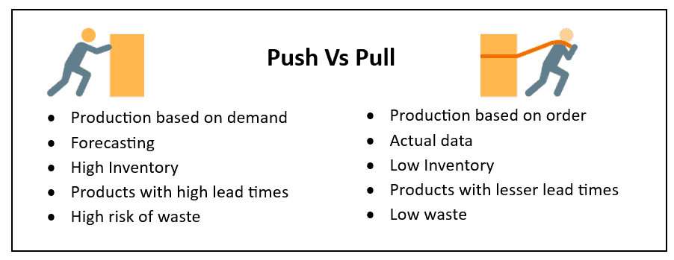
Push based vs Pull based

Slide 4
AWS SQS and AWS SNS
Here are some differences between SQS and SNS:
Foundation: SQS is poll-based, while SNS is push-based.
Relationship: SQS can only have one consumer, while SNS can have many subscribers.
Persistence: SQS has a retention period, while SNS has no persistence.

Slide 5
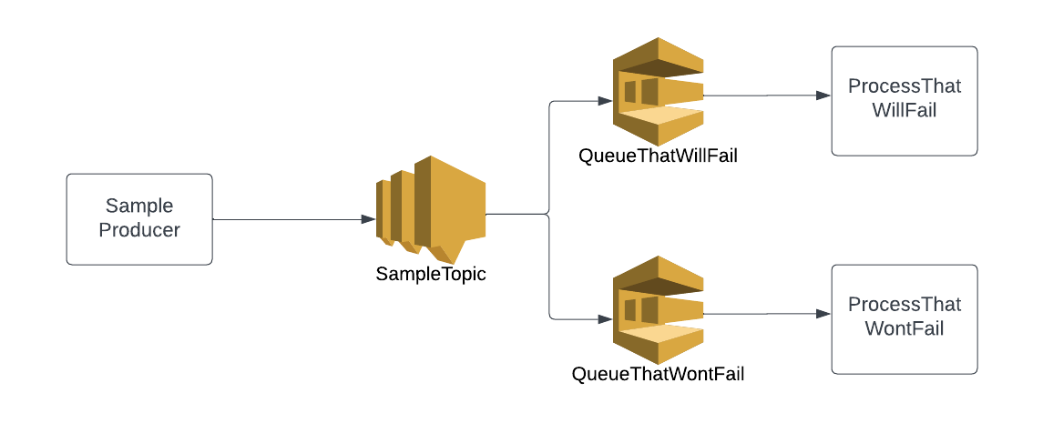
AWS SNS and SQS

Slide 6
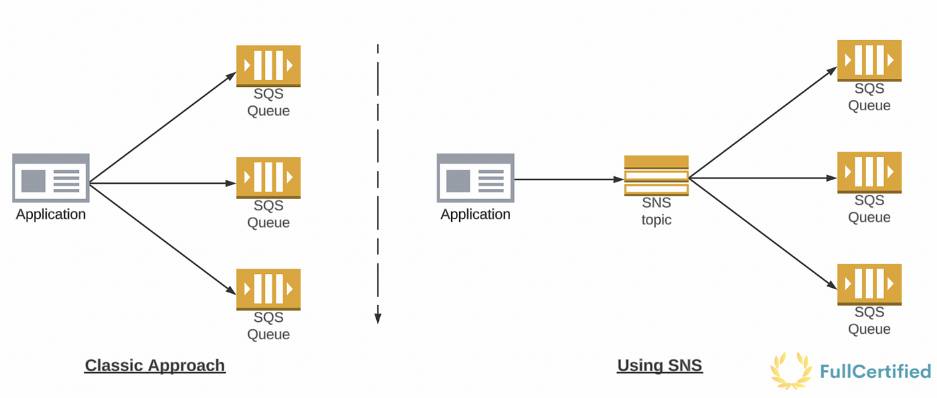
Without and with SNS

Slide 7
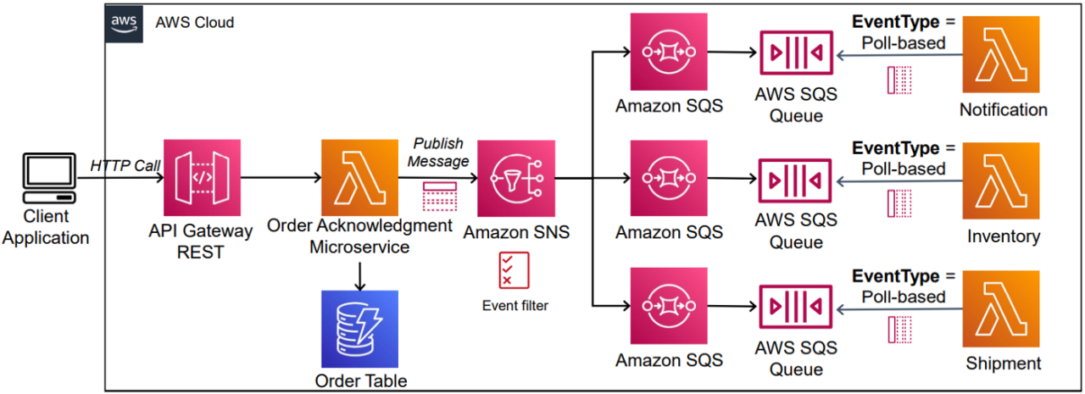
Use case of SQS and SNS

Slide 8
Working with AWS SQS
Go to AWS SQS(Simple Queue Service)
Create a queue with default settings.
Read the different settings info provided.
Leave Access Policy to defaults.
And click on create.
Explore send and receive messages.
Next Copy the ARN as we will use this in AWS SNS(Simple Notification Service)

Slide 9
Working with AWS SNS
Go to AWS SNS(Simple Notification Service).
Create a topic by entering the name.
Keep the defaults and click on Create Topic
Next create subscription.
Choose protocol as Amazon SQS.
Choose the Endpoint as the arn of the SQS.
Now subscription is successfully created.
Next make the SQS queue to subscribe to the SNS Topic in order to be able to receive messages from this SNS topic.
For this get the arn of the topic created.

Slide 10
Back to AWS SQS
Now in the SQS queue that we created earlier, select SNS Subscription.
Choose the ARN of the SNS and click save.
Now test by publishing a message in the SNS Topic and we should receive it in the SQS Queue.
You can fanout the consumer of the SNS topic by creating more SQS Queues.

Slide 11
END

